Slide 1
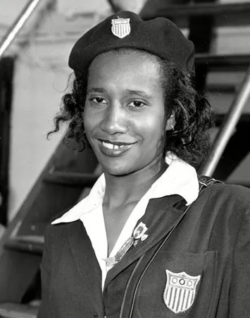

Name: Caochman surname :Alice
1923 | 1948 | 2014
Alice Coachman was born on November 9th in albany
s the first African American to win an Olympic gold medal

Slide 2
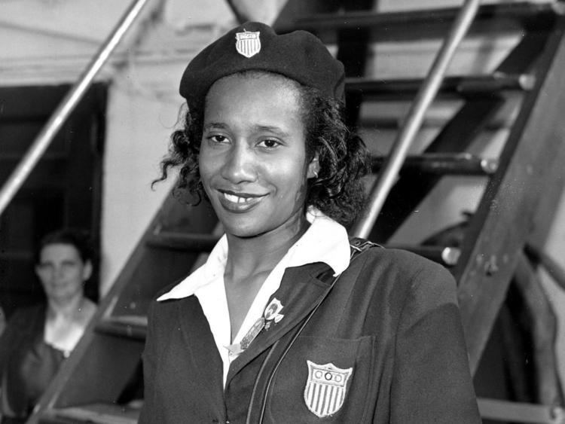

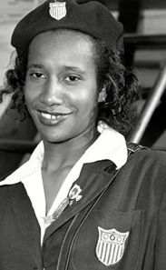
Name : Caochman
Surname : Alice
1923 | 1940 | 2014
Alice Coachman was Born on November 9th in Albany
She became the first African. American Woman to win a gold medal

Slide 3

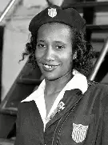
Name :Caochman
Surname : Alice
1923 | 1948 | 2014
Alice coachman was Born on November 9th in Albany
She became the First African. American Woman to Win a gold medal
She died on July 14th in Albany

Slide 4
Thanks you bye

