Slide 1
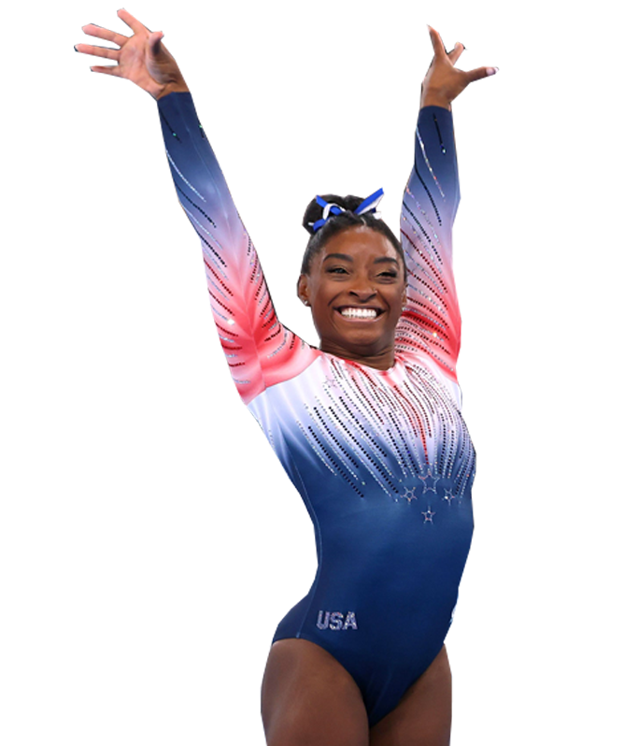
SIMONE BILES
THE GREATEST GYMNASt of all time
Shanelle CAYOL

Slide 2
1997
Simone Arianne Biles was born in Columbus, Ohio
2013
Simone won her first Wold All-around title
2014
She won her second World All-around title
2015
Simone won her third Worl All-around title (historic record)

Slide 3
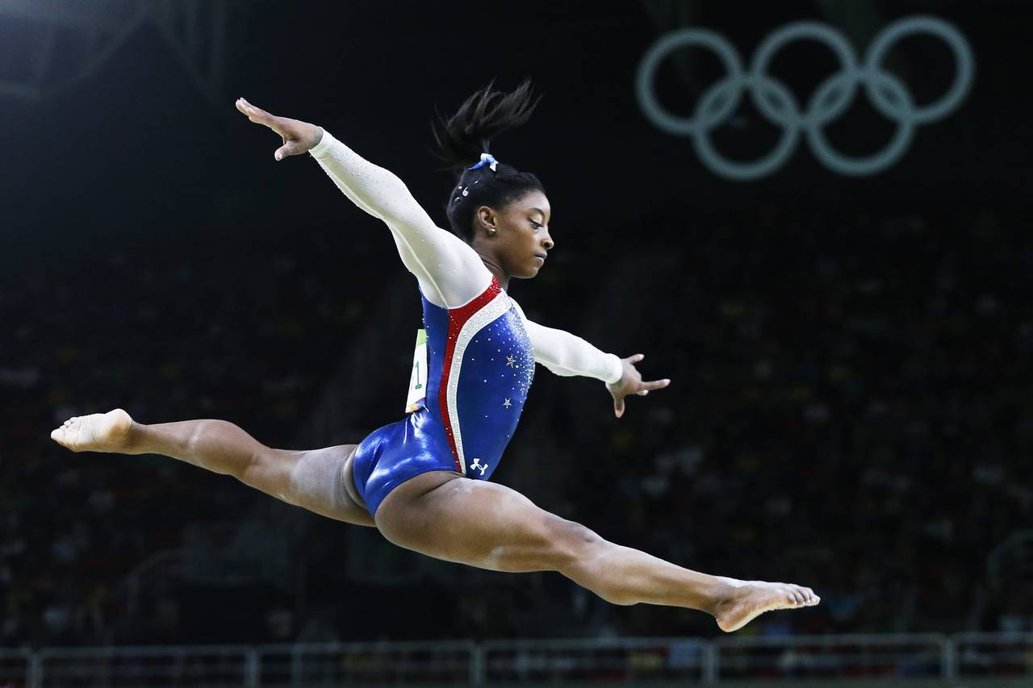
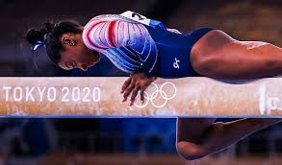
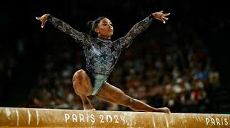
2016
RIO OLYMPICS : Gold and bronze medals
2018
She won World All-Around again
2021
TOKYO OLYMPICS : Gold and bronze medals
2024
PARIS OLYMPICS ; Gold and Silver medals

Slide 4
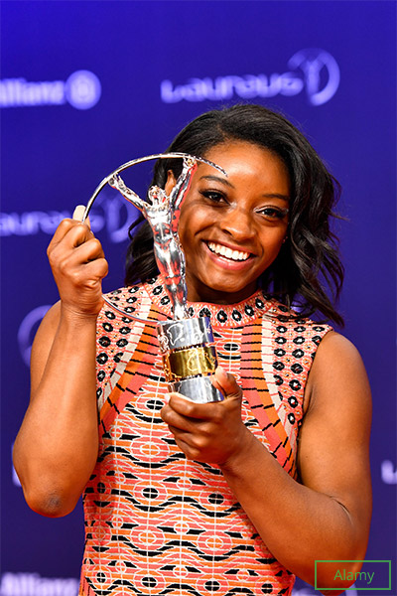
RECORD
BREAKING
RETURNS
2023
She wins her 6th World All-around title
A WORLD RECORD

Slide 5
SIMONE BILES INSPIRED MILLIONS WITH HER TALENT, STRENGTH
AND COURAGE.
SHE CHANGED THE HISTORY OF GYMNASTICS FOREVER

